Slide 1
B V RAJU INSTITUTE OF TECHNOLOGY (UGC Autonomous) Vishnupur, Narsapur, Medak District
Department of CSE(Artificial Intelligence and Machine Learning)
Mini Project – Abstract Review
TITLE: Improved Customer Churn Prediction using CatBoost with Class Balancing and Model Explainability
Guide :
Supervisor : Mrs. P. Akhila
Co-Supervisor: Mr. A B Ramesh

Slide 2
Outline
Motivation
Introduction
Abstract
Datasets Overview
Architecture
Methodology
Outcomes and Impact
Applications
Overview
Literature review

Slide 3
Introduction to Domain
The project lies in the domain of Customer Relationship Management (CRM) and Predictive Analytics.
Telecom and similar sectors face high churn rates due to competition and pricing dynamics.
Data Science helps in identifying churn patterns using historical customer behavior.
Tree-based models like CatBoost and XGBoost provide not only strong predictions but also feature importance scores for interpretability.

Slide 4
Abstract
This work introduces a pavement distress detection system that utilizes the state-of-the-art YOLOv8 object detection model to identify and classify various road surface defects. The system is trained and evaluated on a labeled dataset containing diverse pavement anomalies, including cracks, potholes, and surface wear, with annotations for over a dozen defect categories. To quantitatively assess pavement condition, we introduce the ASPDI (Asphalt Surface Pavement Distress Index), a normalized metric derived from defect coverage in each image. This metric enables rapid evaluation of surface integrity on a scale from 0 (severely damaged) to 100 (pristine).

Slide 5
Dataset Overview
MAPSIA – Manual Asphalt Pavement Surface Image Annotation
MAPSIA is a carefully selected collection of data used to train and test computer programs that can identify damage on roads. It helps in checking roads automatically and maintaining them by using advanced learning techniques.
Total Images: 7,099
Annotations: YOLO format (one .txt file per image with class and bounding box coordinates)
Image Conditions: Captured under various lighting, weather, and road conditions to ensure generalization
Classes (13):
block_crack, long_crack, alligator_crack, pothole, manhole, patching, blurred, white_line, crosswalk, stop_line, double_yellow, curb, background
Data Split :
Training Set : 5,485 images with their corresponding labels.
Validation Set and Test Set : 1073(Validation) and 544(Test) with their corresponding labels.

Slide 6
Dataset Images Overview

Slide 7
LITERATURE REVIEW
S.no. | Year of publication | Title of paper with author name | Objectives | Methods /Approach | Inference
1 | 2021 | Automated Pavement Distress Detection Using Deep Convolutional Neural Networks by Zhang et al. | To automatically identify and classify various pavement distress types using CNNs | Trained deep CNN models on annotated pavement images to classify distress categories | Achieved high classification accuracy, validating deep learning as a strong candidate for road condition assessment
2 | 2022 | Real-time Road Damage Detection Using YOLOv4 by R. Dinesh et al. | To deploy a real-time road damage detection system using YOLO-based object detection | Trained YOLOv4 on annotated road damage datasets; implemented for real-time detection | Model effectively detected cracks and potholes in real time, enabling practical implementation
© BVRIT CSE

Slide 8
LITERATURE REVIEW
S.no. | Year of publication | Title of paper with author name | Objectives | Methods /Approach | Inference
3 | 2022 | Data Augmentation in Pavement Defect Detection Using Albumentations by L. Singh et al. | To improve model generalization by applying diverse image augmentations | Utilized Albumentations library for geometric and pixel-level augmentations on pavement datasets | Enhanced model robustness and reduced overfitting, improving accuracy on unseen data
4 | 2023 | YOLOv5 Based Pavement Distress Detection for Smart Cities by Ahmad S. et al. | To develop a fast and accurate detection system using YOLOv5 for urban roads | Leveraged pretrained YOLOv5, fine-tuned on road damage datasets, used anchor optimization | Demonstrated real-time performance and high accuracy, suitable for integration in smart infrastructure
5 | 2024 | Improving Pavement Distress Localization Using YOLOv7 and Ensemble Learning by Mehta R. et al. | To increase localization precision and reduce false detections using model ensembles | Used YOLOv7 and Weighted Boxes Fusion to combine predictions from multiple models | Significantly improved prediction confidence and consistency across classes
© BVRIT CSE

Slide 9
Methodology Proposed
Dataset Selection/Preparation
Dataset Used: MAPSIA (Manual Pavement Surface Image Annotation)
Classes: 13 types of pavement distress (e.g., block_crack, pothole, curb)
Annotation Format: YOLOv5/YOLOv8 format (.txt files with normalized coordinates)
Split: Train / Validation / Test
Data Preprocessing
Applied augmentations via YOLOv8 built-in pipeline.
Mosaic : Combines 4 random images into one. Helps detect small/overlapping objects.
MixUp : Blends two images and their labels. Acts as regularization and data expansion.
HSV Augmentation : Randomly adjusts hue, saturation, and brightness. Simulates lighting changes.
Horizontal Flip : Random left-right flip to improve spatial generalization.

Slide 10
Contd….
Scaling / Zoom : Random resizing in/out (±10–50%) to simulate object size variation.
Translation : Random shift in X and Y axes to simulate camera/viewpoint variation.
Model Selection
We adopt the YOLOv8 architecture, a modern one-stage detector with superior accuracy-speed trade-off.
YOLOv8’s lightweight structure supports real-time inference while maintaining high detection precision.
Training Pipeline
The model is trained on the prepared MAPSIA dataset using supervised learning.
Optimized using a combination of classification, objectness, and bounding box regression losses.
Performance is monitored using standard object detection metrics, including mAP@0.5 and mAP@0.5:0.95.

Slide 11
Contd….
Evaluation & Interpretation
The model's detection capabilities are evaluated on a held-out test set.
Inference results are visually interpreted by overlaying predicted bounding boxes and class labels.
Additionally, a Pavement Distress Index (ASPDI) is computed using the output to provide a quantitative road quality score.

Slide 12
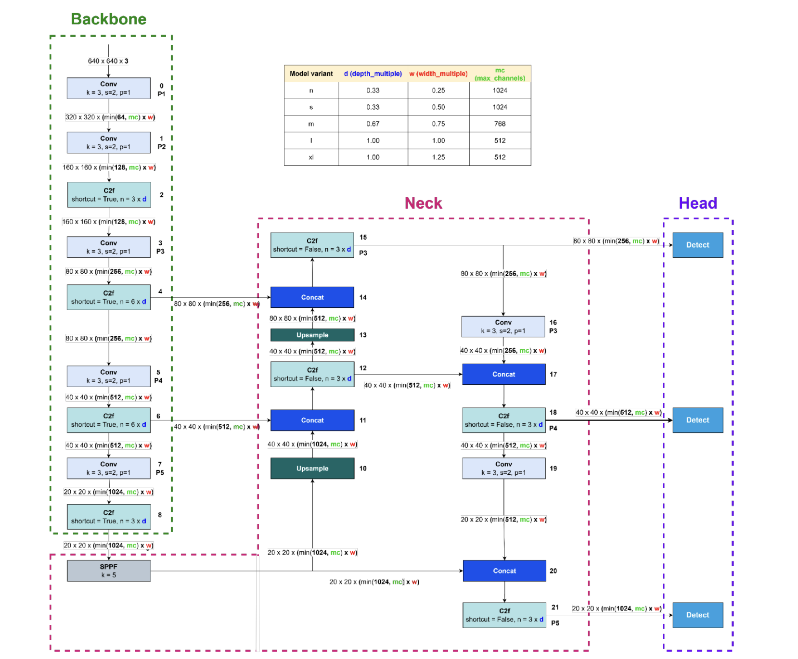
Architecture (Yolov8)
Yolov8 Architecture

Slide 13
Contd….
1. Backbone (Feature Extraction)
The backbone is responsible for extracting visual features from the input image.
Starts with convolutional layers and then applies C2f modules, which are enhanced residual bottlenecks.
Feature maps are downsampled from 640×640 to 20×20, capturing multi-scale information.
Layer | Operation | Purpose
P1 - P5 | Conv + C2f Modules | Extract local and global features
SPPF | Spatial Pyramid Pool | Enrich context with multi-scale pooling

Slide 14
Contd….
2. Neck (Feature Aggregation)
The neck fuses features from different resolutions for better localization and classification.
Uses FPN-style architecture with:
Upsampling to increase resolution.
Concat to merge features from different stages.
C2f modules for further refinement.
Operation | Description
Upsample | Enlarges feature maps to combine with higher-resolution features
Concat | Fuses features from different scales
C2f | Refines features using lightweight, deeper paths

Slide 15
Contd….
3. Head (Detection Layer)
Final detection heads operate at 3 different scales:
80×80 (P3) for small objects
40×40 (P4) for medium objects
20×20 (P5) for large objects
Each detection head predicts:
Bounding boxes
Objectness score
Class probabilities

Slide 16
Implementation
Environment & Dependencies
Installed libraries: ultralytics, ensemble-boxes, albumentations
Frameworks used: PyTorch, OpenCV, Albumentations, Matplotlib
We begin by setting up our environment using key libraries. YOLOv8 is handled by the Ultralytics package. For augmentations and preprocessing, we use Albumentations, and OpenCV with Matplotlib helps in visualization.
Model & Dataset Configuration
Model: yolov8m.pt (YOLOv8 Medium)
Number of classes: 13
Class labels:
block_crack, alligator, diagonal, longitudinal, irregular, transverse, lane_crack, patch, pothole, drain, manhole, ravelling, sealed
We load a pre-trained YOLOv8 medium model and customize it to detect 13 different pavement distress types defined in our dataset configuration.

Slide 17
Implementation
Image Preprocessing & Augmentation
Resized to 640x640.
Augmentations applied:
Random brightness/contrast
Horizontal flip
Normalization and tensor conversion.
In this step, we resize the image to match the input dimensions expected by YOLOv8. Then, we apply light augmentations like random brightness/contrast and horizontal flipping to slightly vary the input. Finally, the image is normalized and converted to a PyTorch tensor. This helps simulate variability, even during inference.
Model Training
Trained on mapsia dataset with:
epochs=30, imgsz=640, batch=16
Augmentations: mosaic=1.0, mixup=0.5, augment=True.

Slide 18
Implementation
Post-processing with WBF
Normalized box coordinates
Fuses overlapping boxes
Keeps highest confidence score.
To improve detection accuracy, we use Weighted Box Fusion. It takes overlapping boxes from the YOLO output and combines them into one, weighing them based on confidence scores. This step reduces duplicate boxes and false positives.
Visualization
Draw bounding boxes using OpenCV
Annotate each with class name and confidence
Display image using Matplotlib
In the final step, we use OpenCV to draw bounding boxes and annotate them with class names and confidence levels. This gives us a clean, interpretable output image showing all detected distress areas.

Slide 19
Results
Validation Metrics
Metric | Value
Precision(P) | 0.637
Recall(R) | 0.597
mAP@0.5 | 0.615
mAP@0.5:0.95 | 0.425
Final Losses:
box_loss: 0.8927 → Bounding box prediction error
cls_loss: 0.8934 → Classification error
dfl_loss: 1.176 → Distance from predicted to target box edge

Slide 20
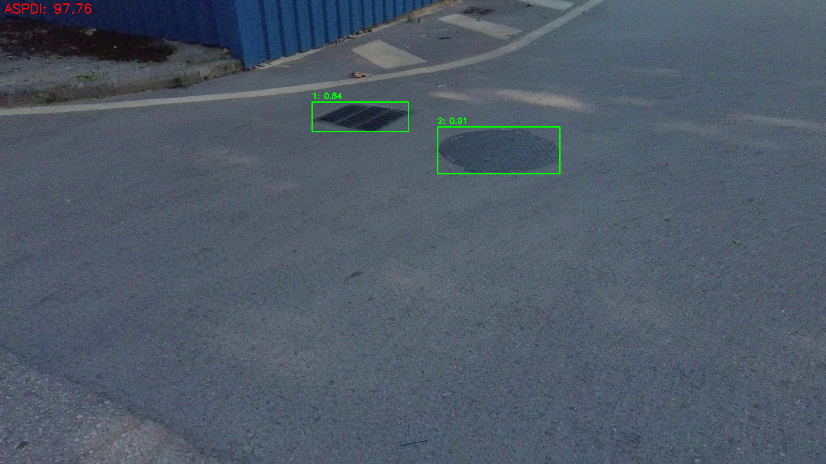
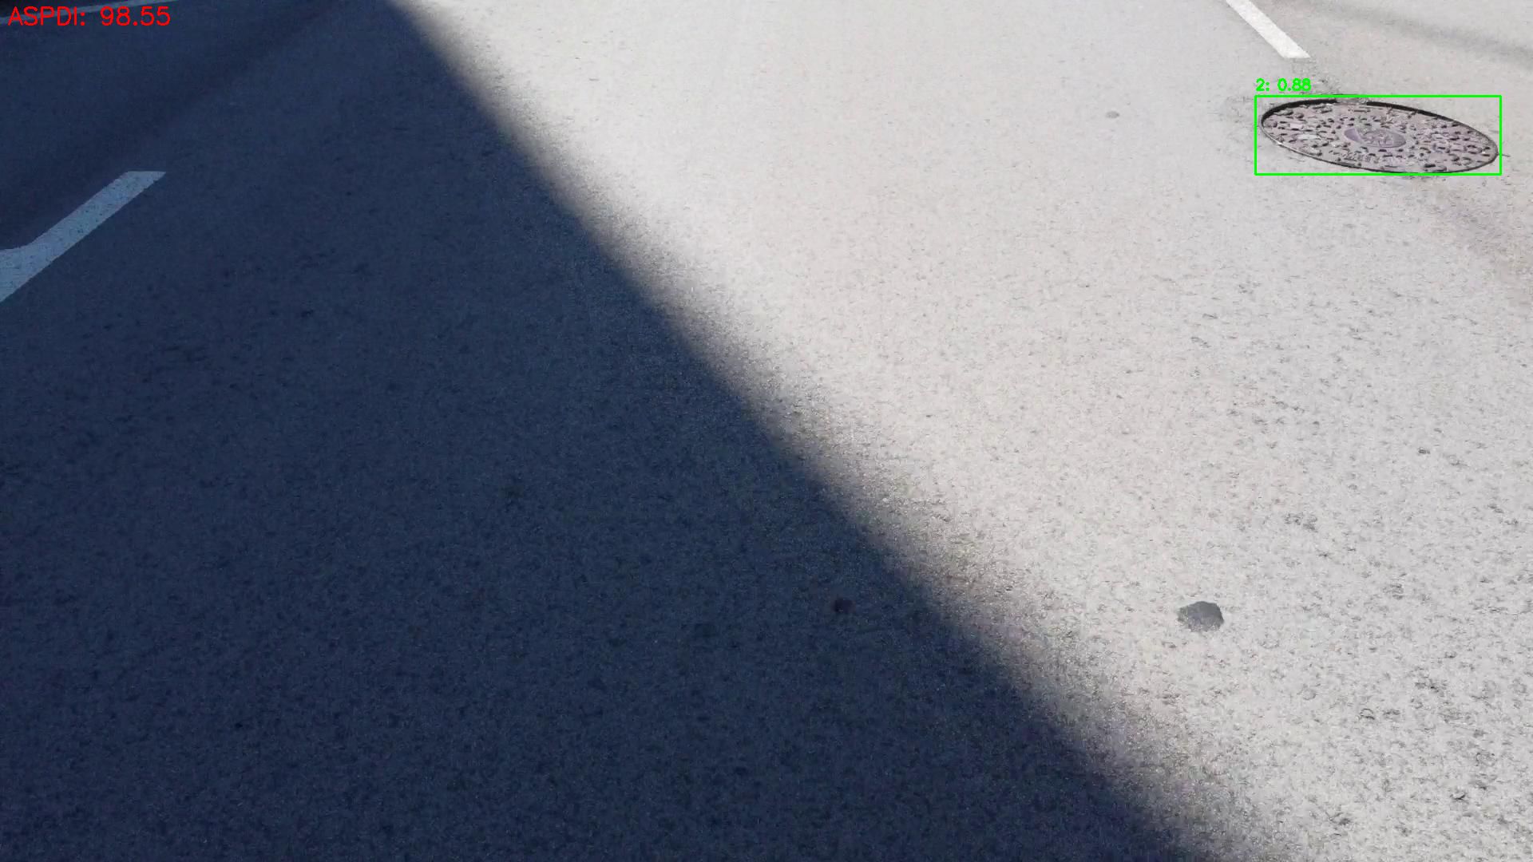
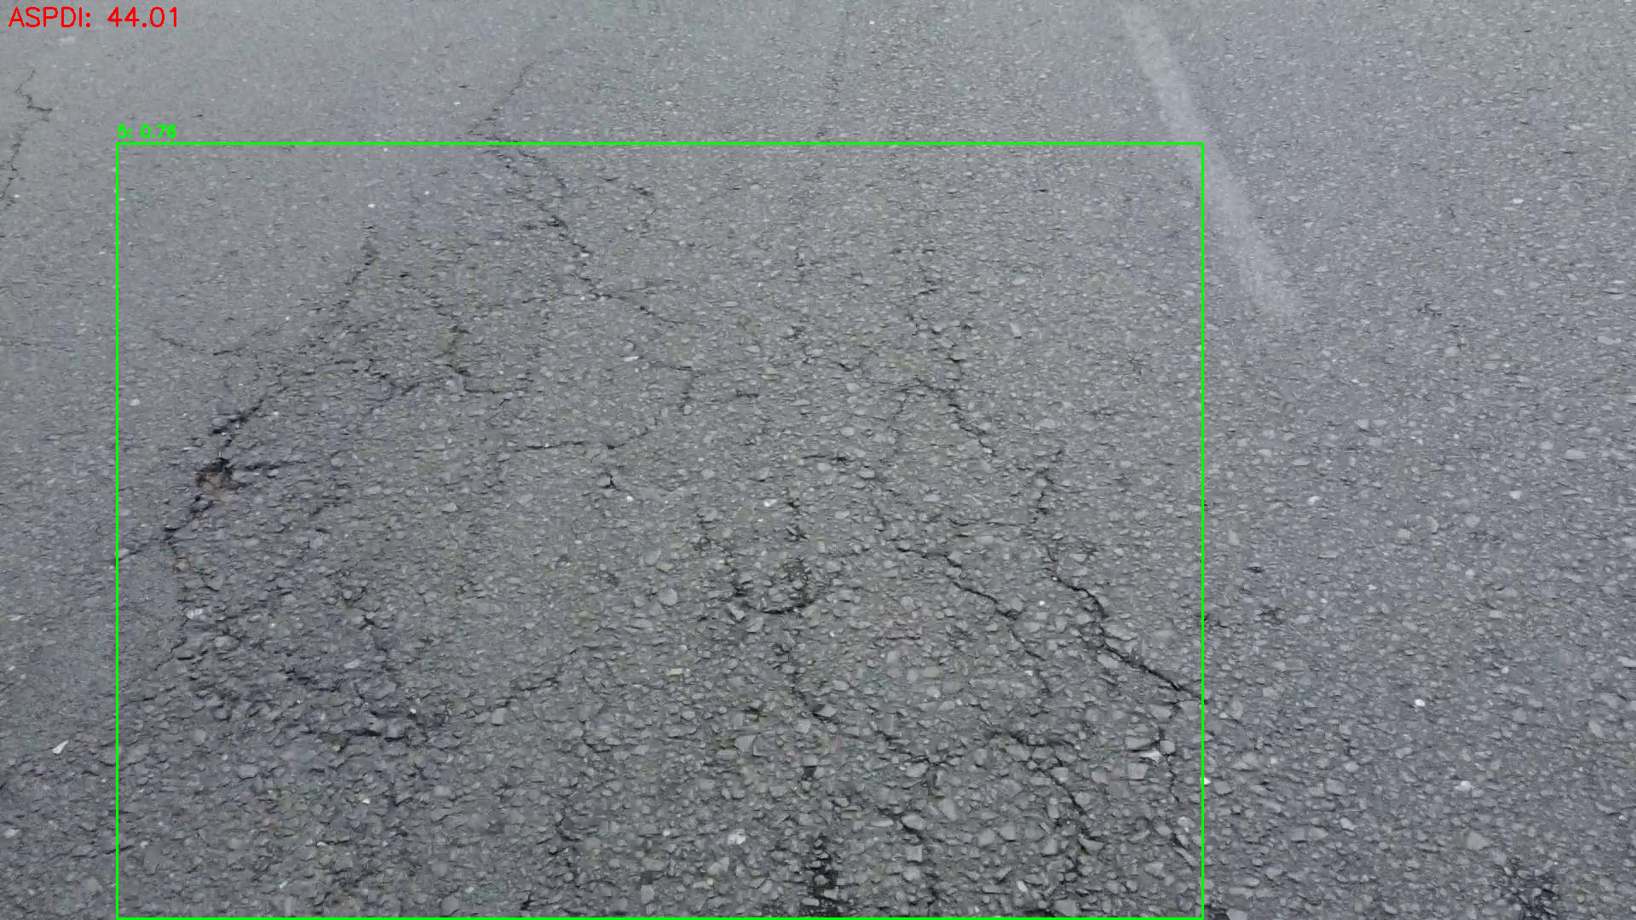
Results (Some Inferences)

Slide 21
Results
Interpretation:
The model is moderately accurate at both detecting objects (recall) and confirming they are correct (precision).
A mean Average Precision (mAP) of ~61.5% at IoU threshold 0.5 indicates reasonable detection quality.
The lower mAP@0.5:0.95 (42.5%) reflects difficulty across tighter IoU thresholds — expected for complex multi-class object detection tasks.
Per-Class Evaluation:
Highest performing classes:
D11 → P: 0.965, R: 0.927, mAP@0.5: 0.961
D10 → P: 0.928, R: 0.841, mAP@0.5: 0.884
Lower performing:
D9 (background noise class): mAP@0.5: 0.284 → hard to distinguish or noisy labels

Slide 22
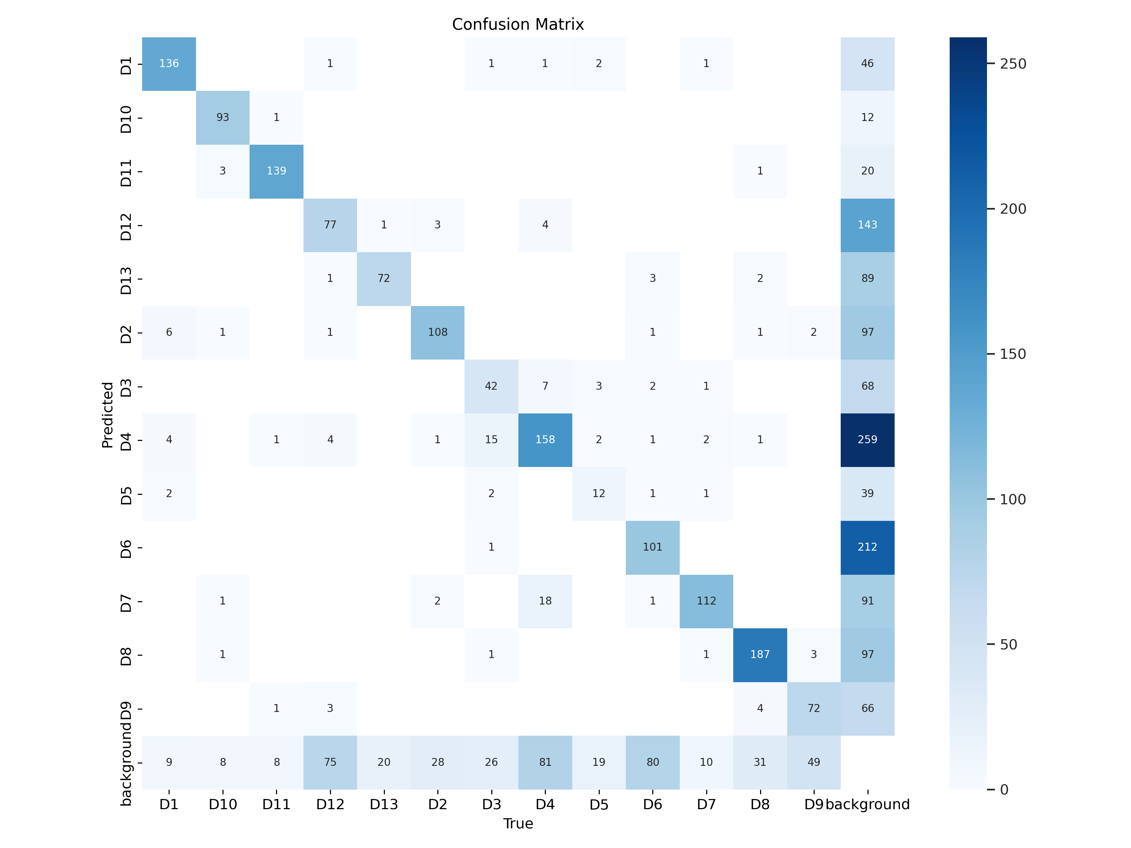
Results
Confusion Matrix

Slide 23
Results
Results Summary :
Most diagonal values are strong, indicating solid performance for many classes
However, confusion with background (D9) suggests:
Some classes share similar textures or patterns
Possible dataset imbalance or overlapping visual features

Slide 24
Outcomes and Impact
Achieved better accuracy and F1-score using stacking.
Ensemble learning reduced overfitting and improved generalization.
Identified key churn indicators such as contract type, tenure, and service usage.
Model output is interpretable and applicable for real-time customer management.
Supports data-driven decision making across departments like sales, support, and marketing.

Slide 25
Overview
Objective: To build a robust and interpretable churn prediction system using stacking ensemble learning.
Approach: Combine the predictions of CatBoost, LightGBM, and XGBoost using logistic regression as a meta-learner. Focus on data quality, model performance, and feature interpretability.
Outcome: A high-performing churn classifier with actionable business insights, helping companies enhance customer retention strategies.

Slide 26
THANK YOU

